Slide 1
FORCASTING OF STOCK PRICE(RIL)
ATUL CHAUDHARI
MOHNISH LAVANIA
SARANG BAGUL
RISHIK SHARMA
RAHUL SINGH

Slide 2
TOOLS USED:
PYTHON
PMDARIMA
METHODOLOGY:
ACF/PACF
DATASIZE:
1330X5

Slide 3
MODELS USED
SIMPLE EXPONENTIAL
HALTS EXPONENTIAL
HALT’S WINTER EXPONENTIAL
ARIMA
AUTO_ARIMA
SARIMA
LOG_SPLIT
LOG_SPLIT_2

Slide 4
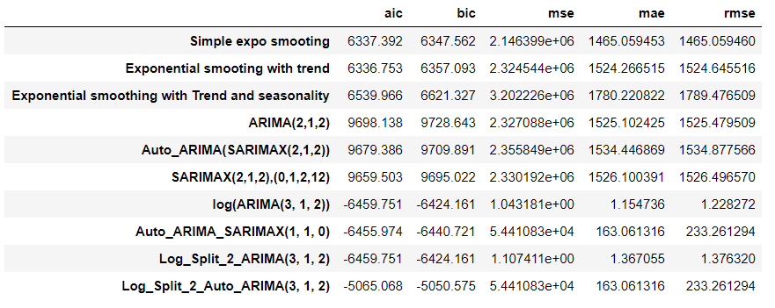
Comparison of models

Slide 5
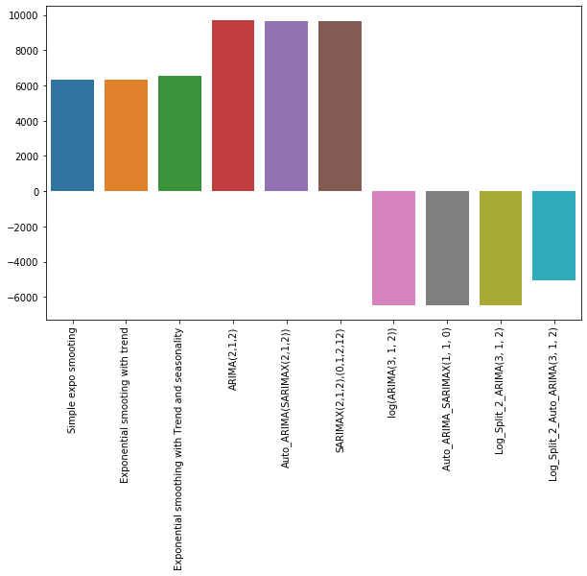
AIC

Slide 6

BIC

Slide 7
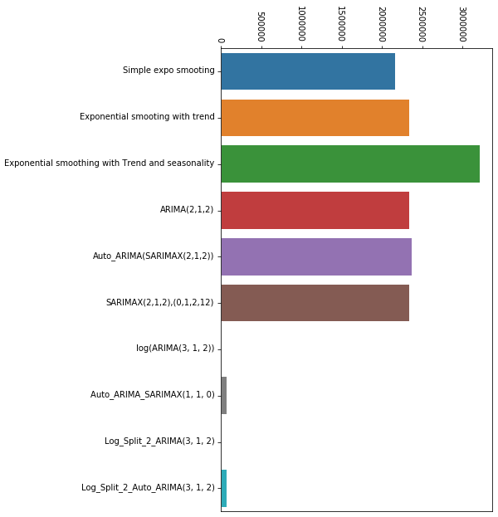
MSE

Slide 8
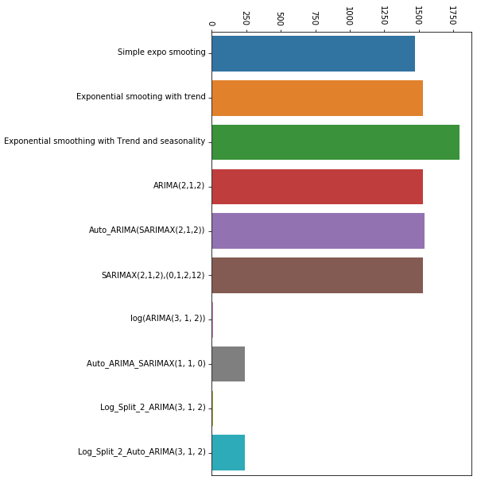
RMSE

Slide 9
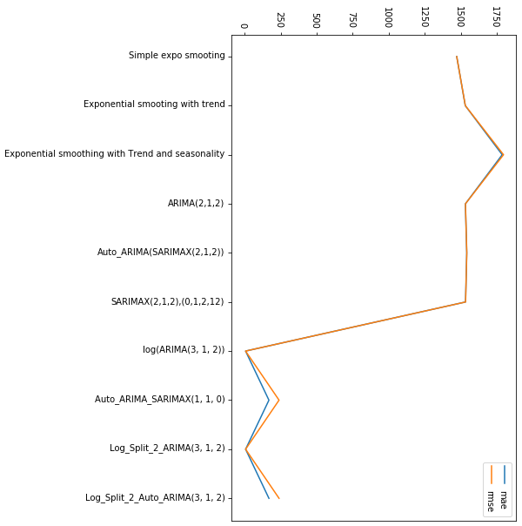
MAE VS RMSE

